Slide 1

TensorFlow
Sources::
Nikhil Budua, Fundamentals of Deep Learning, Designing Next Generation Artificial Intelligence Algorithms, First edition, O’Reilly Publications, 2016 [Chapter 3]
2. https://www.datacamp.com/community/tutorials/tensorflow-tutorial
3. https://www.tensorflow.org/
Final Year BTECH
Subject : Deep Learning (PE4)

Slide 2
TensorFlow Features

Slide 3
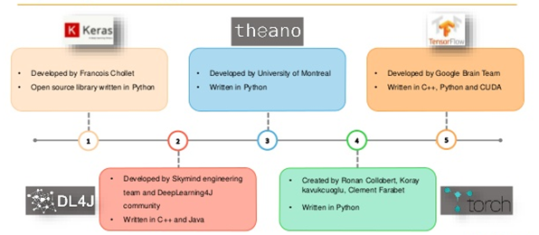
Deep Learning Libraries
Keras : Developed by Francois Chollet. Open source library written in Python.
Theano : Developed by University of Montreal. Written in Python.
Tensorflow : Developed by Google Brain Team. Written in C++, Python and CUDA.
DL4J : Developed by Skymind engineering team and DeepLearning4J community. Written in C++ and Java.
Torch : Created by Ronan Collobert, Koray kavukcuoglu, Clement Farabet. Written in Lua.

Slide 4
How Does TensorFlow Compare to Alternatives?
A number of libraries that have popped up over the years for building deep neural networks. These include Theano, Torch, Caffe, Neon, and Keras
One of the drawbacks of Torch, however, is that the framework is written in Lua. Lua is a scripting language much like Python, but is less commonly used outside the deep learning community.
TensorFlow was built with production use in mind, whereas Theano was designed by researchers almost purely for research purposes.
As a result, TensorFlow has many features out of the box and in the works that make it a better choice for real systems (the ability to run in mobile environments, easily build models that span multiple GPUs on a single machine, and train large-scale networks in a distributed fashion).
Nikhil Budua, Fundamentals of Deep Learning, Designing Next Generation Artificial Intelligence Algorithms, First edition, O’Reilly Publications, 2016 [Chapter 3]

Slide 5
TensorFlow
What is TensorFlow?
Open source software library from Google (Brain Team) released in 2015.
Especially good for training and implementing deep neural networks.
Applications include image recognition, classification and prediction, language understanding.
Used in production at Uber, SnapChat, Google, others
Nikhil Budua, Fundamentals of Deep Learning, Designing Next Generation Artificial Intelligence Algorithms, First edition, O’Reilly Publications, 2016 [Chapter 3]
Notes:
Reference:

Slide 6
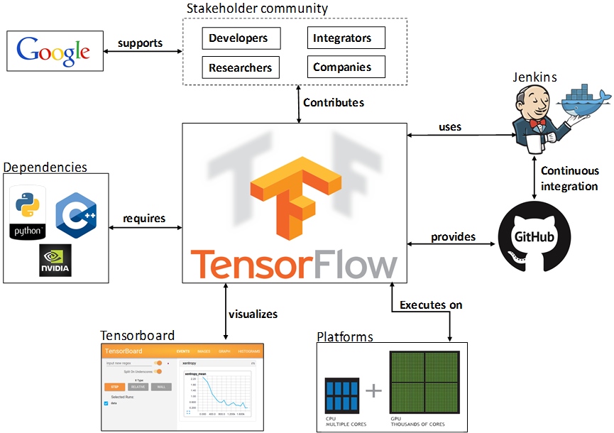
TensorFlow

Slide 7
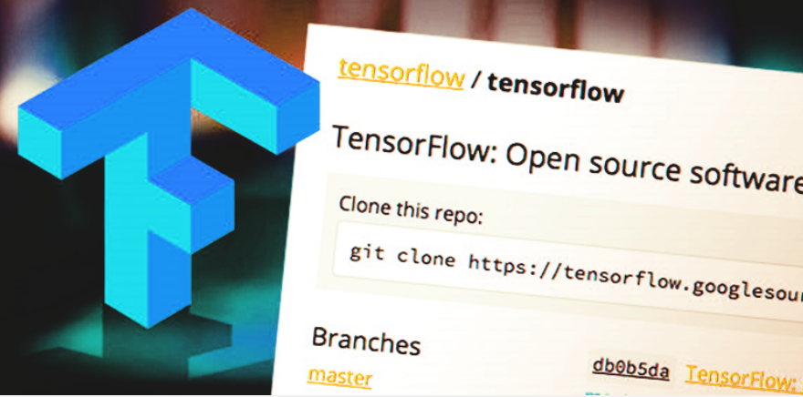
TensorFlow
An interface for expressing & implementing the machine learning algorithms
A framework for creating ensemble algorithms for today’s most challenging problems. – Google Brain Team
Notes:
Reference:

Slide 8
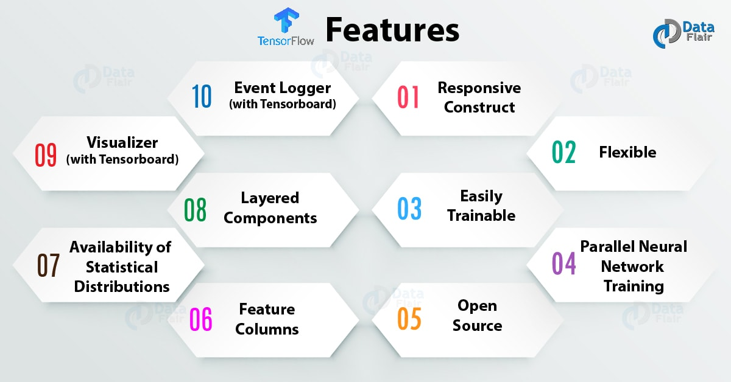
TensorFlow Features
Src: https://data-flair.training/blogs/tensorflow-features/

Slide 9
TensorFlow Features
Responsive Construct
With TensorFlow we can easily visualize each and every part of the graph which is not an option while using Numpy or SciKit.
Flexible
One of the very important Tensorflow Features is that it is flexible in its operability, meaning it has modularity and the few parts of it can be made standalone.
Easily Trainable
It is easily trainable on CPU as well as GPU for distributed computing.

Slide 10
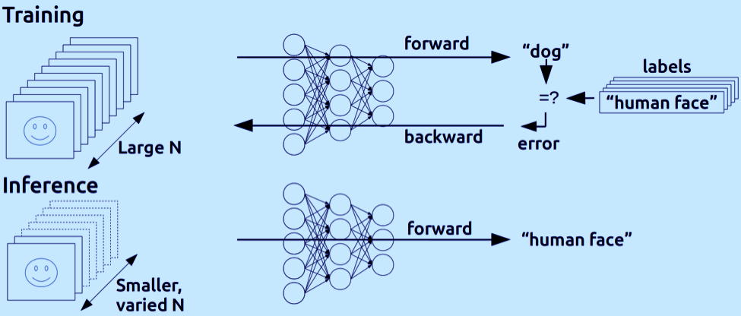
TensorFlow Features
Parallel Neural Network Training
TensorFlow offers pipelining in the sense that you can train multiple neural networks and multiple GPUs which makes the models very efficient on large-scale systems.

Slide 11
TensorFlow Features
Large Community
A large team of software engineers who work on stability improvements continuously.
Open Source
The best thing about this Machine Learning library is that it is open source so anyone can use it as long as they have internet connectivity.
The Users manipulate the library in ways unimaginable and come up with an amazing variety of useful products, it has become another DIY community which has a huge forum for users getting started with it and for those who find it hard to use it or to get help with their work.

Slide 12
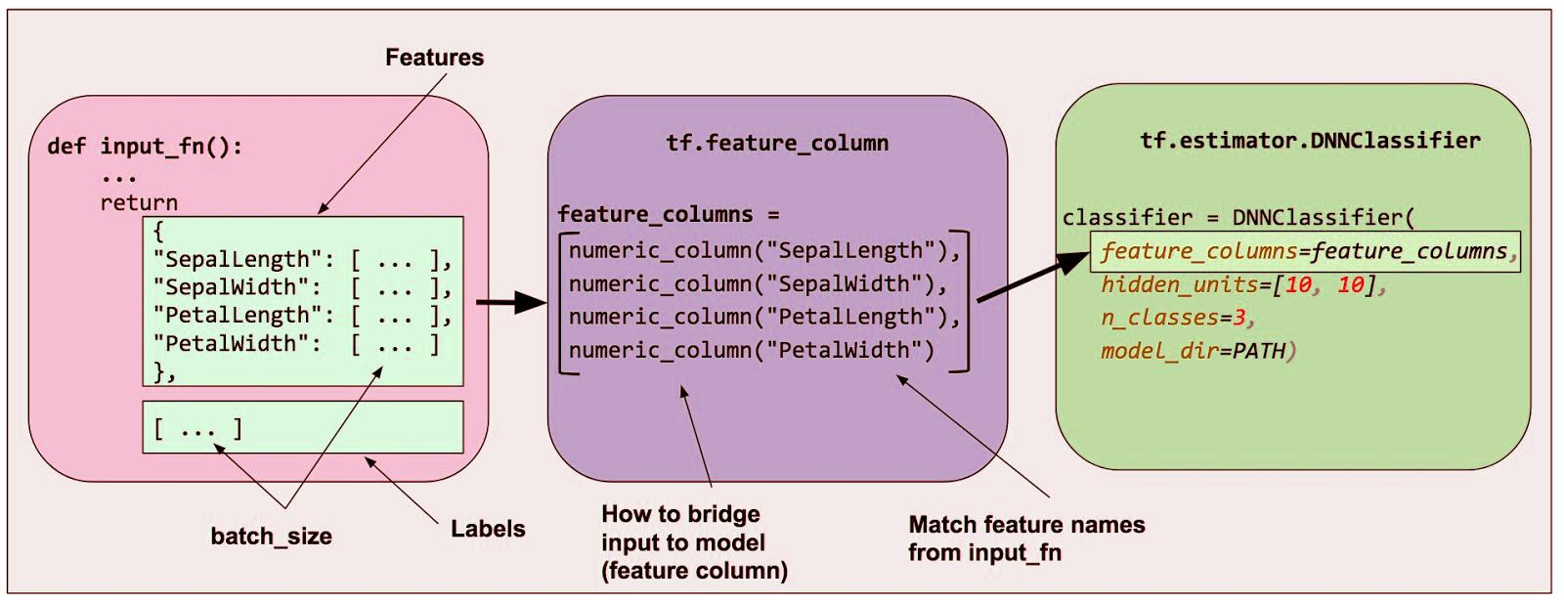
TensorFlow Features
Feature Columns
Tensorflow has feature columns that could be thought of as intermediaries between raw data and estimators, therefore, bridging input data with the model.

Slide 13
TensorFlow Features
Availability of Statistical Distributions
The library provides distribution functions including Bernoulli, Beta, Chi2, Uniform, Gamma, which are important especially while considering probabilistic approaches such as Bayesian models.
Layered Components
TensorFlow includes functions like tf.contrib.layers that produce layered operations of weights and biases.
Also provides batch normalization, convolution layer, dropout layer, etc.
So tf.contrib.layers.optimizers has optimizers such as Adagrad, Momentum, etc. which are often used to solve optimization problems for numerical analysis, it provides initializers with tf.contrib.layers.initializers used to maintain the gradient scale.

Slide 14
TensorFlow Features
Visualizer (with TensorBoard)
TensorBoard is a totally different visual representation of a model that helps for debugging too.
Event Logger (with TensorBoard)
So, just like UNIX, where you use tail –f <log_file > to monitor the output of tasks at the cmd and do quick checks, logging events in Tensorflow allows doing the same by logging events and summaries from the graph and the output over time with TensorBoard.

Slide 15
TensorFlow Applications
Image Recognition – Ever since Alex Krizhevsky winning the ImageNet challenge in 2012, convolutional neural networks have burst out in popularity and almost every month new architectures are surfacing with increased accuracy scores. Tensorflow is one of the foremost implementation choices for these applications
Virtual Assistant – Chatbots have seen a significant rise in popularity in the year 2017. It is expected to maintain this trend. Understanding computational linguistics and deliver a high-end deep learning algorithm that can process text is one of the most sought after skills as of today.
Self-driving cars – They use a variety of sensory inputs to determine every move, be it changing lanes to detecting traffic signals and stopping, detecting humans, other cars etc. Tensorflow is used in almost all the current self-driving cars that we see.

Slide 16
Tensorflow Installation

Slide 17
Installation of TensorFlow
System requirements
•Python 3.6–3.8
•Python 3.8 support requires TensorFlow 2.2 or later.
•pip 19.0 or later
•Ubuntu 16.04 or later (64-bit)
•macOS 10.12.6 (Sierra) or later (64-bit) (no GPU support)
•Windows 7 or later (64-bit)
•Microsoft Visual C++ Redistributable for Visual Studio 2015, 2017 and 2019
•GPU support requires a CUDA®-enabled card (Ubuntu and Windows)
•Installing TensorFlow 2 requires a newer version of pip
Notes:
Reference:

Slide 18
Installation of TensorFlow
TensorFlow 2 packages are available
•tensorflow - Latest stable release with CPU and GPU support (Ubuntu and Windows)
•tf-nightly - Preview build (unstable) . Ubuntu and Windows include GPU support .
Check if Python environment is already configured:
Python 3.6–3.8, pip and venv >= 19.0
•python3 --version
•pip3 --version
Notes:
Reference:

Slide 19
Installation of TensorFlow
1)Determine which TensorFlow to install
- TensorFlow with CPU support
- TensorFlow with GPU support
2) Install TensorFlow using :
- "native" pip
- Anaconda
3) Installing using Anaconda
C:> conda create -n tensorflow pip python=3.5
C:> activate tensorflow
Your prompt should change
C:> pip install tensorflow
C:> pip install --ignore-installed --upgrade tensorflow
Jupyter Notebook
Notes:
Reference:

Slide 20
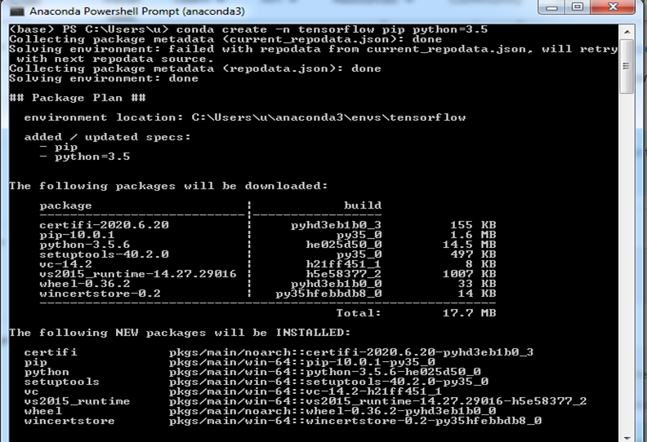
Installation of TensorFlow
Notes:
Reference:

Slide 21
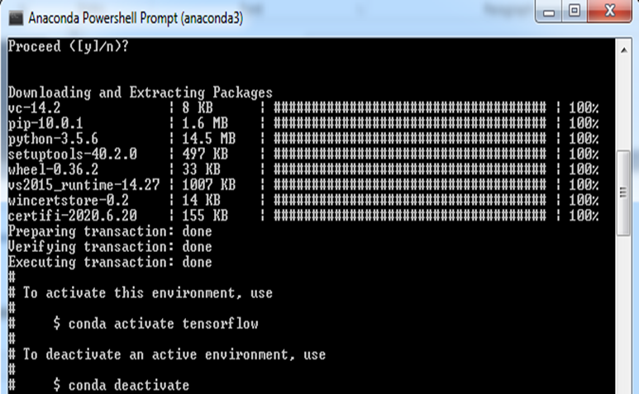
Installation of TensorFlow
Notes:
Reference:

Slide 22
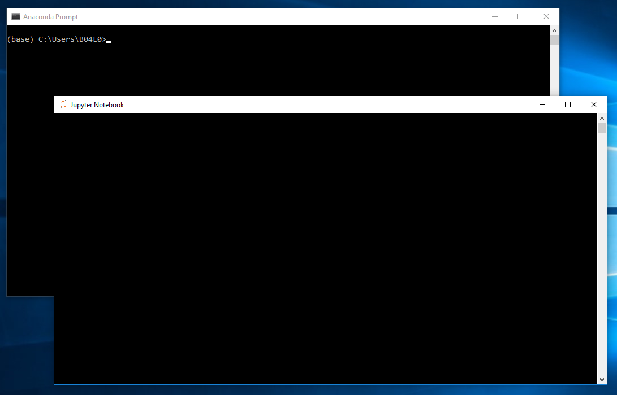
Starting with Tensorflow Programming

Slide 23
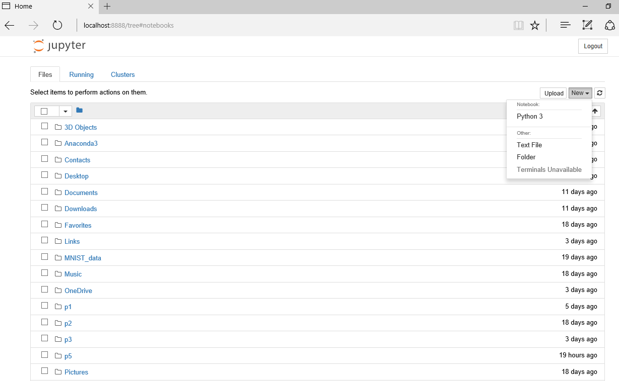

Slide 24
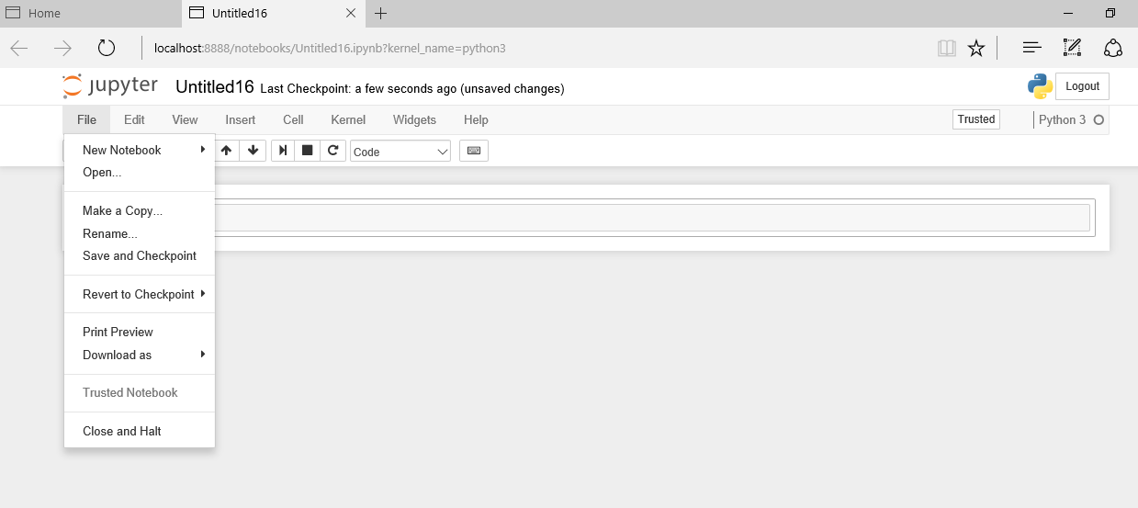

Slide 25
Building blocks of Tensorflow

Slide 26
Tensors
Tensor are the standard way of representing data in Tensorflow
All the operations are conducted inside the graph .
Tensolrflow allows to create dataflow graphs which shows how data moves through a graph.
Each node represents a mathematical operations.
Nodes and the tensors in tensorflows are the python objects.

Slide 27
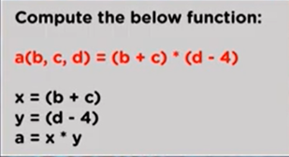
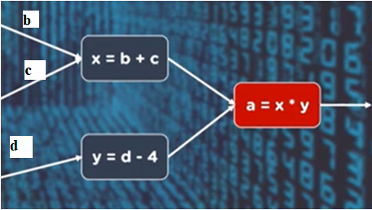
How Tensorflow works?

Slide 28
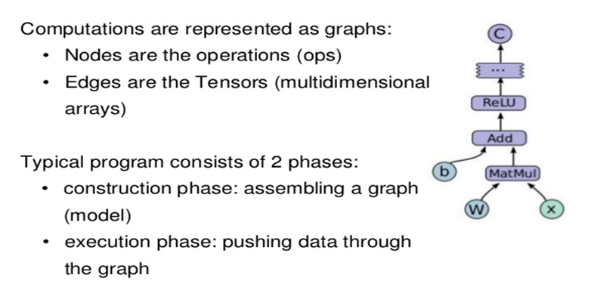
Data Flow Graph

Slide 29
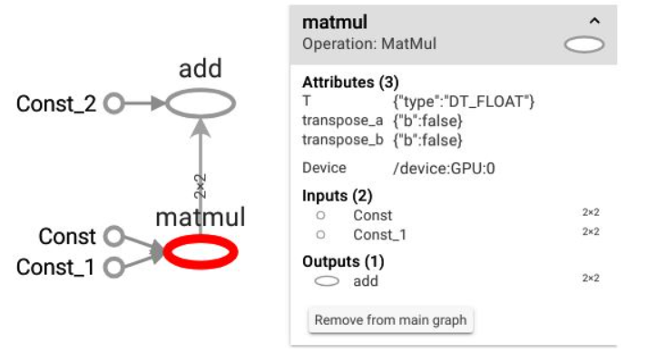
Why two phases in Classic Tensorflow?
- Building Computational Graph
- Running Computational Graph (Session)

Slide 30
Fig Source: https://johncarlosbaez.wordpress.com/2016/06/05/programming-with-data-flow-graphs/

Slide 31
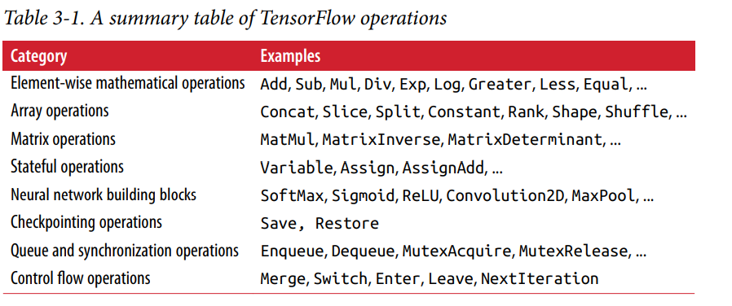
TensorFlow Operations
Nikhil Budua, Fundamentals of Deep Learning, Designing Next Generation Artificial Intelligence Algorithms, First edition, O’Reilly Publications, 2016 [Chapter 3]

Slide 32
Creating and Manipulating TensorFlow Variables
When we build a deep learning model in TensorFlow, we use variables to represent the parameters of the model. TensorFlow variables are in-memory buffers that contain tensors; but unlike normal tensors that are only instantiated when a graph is run and that are immediately wiped clean afterward, variables survive across multiple executions of a graph.
TensorFlow variables have the following three properties:
• Variables must be explicitly initialized before a graph is used for the first time.
• We can use gradient methods to modify variables after each iteration as we search for a model’s optimal parameter settings.
• We can save the values stored in variables to disk and restore them for later use.
(These three properties are what make TensorFlow especially useful for building machine learning models.)
Nikhil Budua, Fundamentals of Deep Learning, Designing Next Generation Artificial Intelligence Algorithms, First edition, O’Reilly Publications, 2016 [Chapter 3]

Slide 33
Data Types in Tensorflow
Python Type Description
(dtype)
tf.float32 32-bit floating point
tf.float64 64-bit floating point
tf.int64 64-bit signed integer
tf.int32 32-bit signed integer
tf.int16 16-bit signed integer
tf.uint8 8-bit unsigned integer
tf.string Variable length byte arrays.
tf.bool Boolean

Slide 34
Reading data in Tensorflow
There are three main methods of getting data into a TensorFlow program:
Preloaded data:
- a constant or variable in the TensorFlow graph holds all the data (for small data sets).
Feeding:
- Supply feed data through the feed_dict argument to a run() or eval() call that initiates computation.
Reading from files:
-Pass the list of filenames to the tf.train.string_input_producer function.
-To read text files in comma-separated value (CSV) format, use a tf.TextLineReader with the tf.decode_csv operation.

Slide 35
Preloaded data:
[ import tensorflow as tf ]
Constant x = tf.constant(35, name='x')
Variable y = tf.Variable(15, name='y')
Placeholder a=tf.placeholder(tf.float32)

Slide 36
How to use Constant and Variable ?
If we define a tf constant when we print it, we get a Tensor object and not its value
x = tf.constant(1, dtype=tf.float32, name="X")
print(x)
> Tensor("Node X:0", shape=(), dtype=float32)
Now, let’s observed the below code, and evaluate this node. We’ll need to create a tf.Session that will take care of actually evaluating the graph
with tf.Session() as sess:
print(sess.run(x)) # x.eval()
> 1.0
# x = tf.constant(1, name=“X”)

Slide 37
Code Basics
1) Building Computational Graph
import tensorflow as tf
node1=tf.constant(5.0)
node2=tf.constant(6.0)
print(node1,node2)
2) Running Computational Graph (Session)
Way1
sess=tf.Session()
print(sess.run([node1,node2])
sess.close()
Way 2
with tf.compat.v1.Session() as sess:
output=sess.run([node1,node2])
print(output)

Slide 38
Using Tensorboard
import tensorflow as tf %load_ext tensorboard # Load the TensorBoard notebook extension
with tf.compat.v1.Session() as sess:
a=tf.constant(4,name="input_A")
b=tf.constant(6,name="input_B")
c=tf.add(a,b,name=“Result")
writer=tf.compat.v1.summary.FileWriter("./logs",sess.graph)
print(sess.run(c))
sess.close()

Slide 39

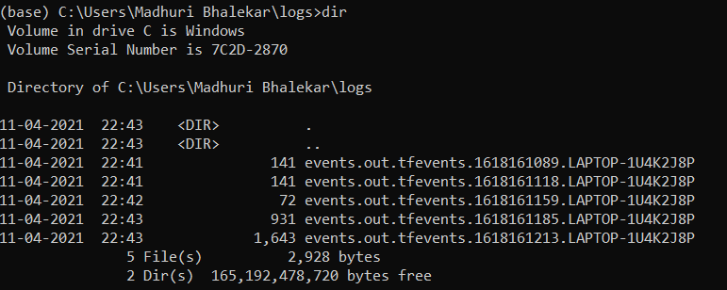
How to use Tensorboard?
Run it on Anaconda Command Prompt: %tensorboard –logdir logs

Slide 40
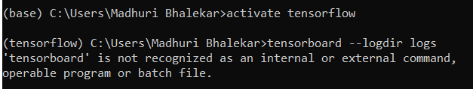
How to use Tensorboard?

Slide 41
How to use Tensorboard?
If graph is not visible on tensorboard use following command on Anaconda command prompt
>tensorboard dev upload --logdir \log

Slide 42
